Slide 2
We are back in Izmir!

Slide 3
What is JUSTRI
Not-for-profit organisation based in the UK
We work to improve education and interaction between patients, doctors and other healthcare workers, industry and governments in the area of HIV and allied conditions
We aim to do what people want and help them get what they need
We focus on SEE and MENA but also look to expand our help

Slide 4
Who are JUSTRI
A small core group who plan and co-ordinate projects
A much larger group of people who work with us as speakers and implementers
Doctors, nurses, patients, pharmacists
Finally all who come to our events who we hope will continue to be part of the family we have developed

Slide 5
Bless you Robin

Slide 6
Aims of this meeting
To teach you the history and use of PREP
To discuss PREP plans for Turkey
To find out what you need or want
This is your opportunity to ask for anything - use it
All the slides will be e-mailed to you after the meeting as well as your certificate

Slide 7
Housekeeping
Deniz knows everything – just ask her
If there is a fire just run
Toilets are somewhere in the building
Turn your phones off or to silent

Slide 8
What does JUSTRI do
Develop resources
Run meetings and trainings
Try to build and develop relationships
Focus on ‘Supporting the Front-line’
See it all at www.justri.org

Slide 9
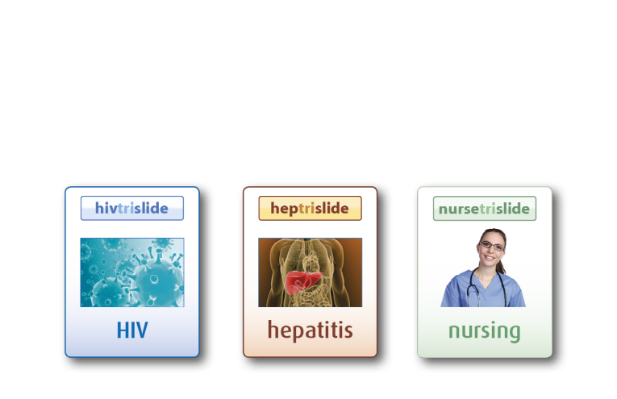
A free online slide library for HIV, TB, Hepatitis and Nursing
^{Now over 14,000 slides sets}

Slide 10
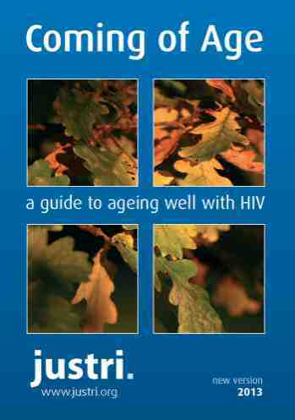
How-to Guides
HIV women’s clinic
Viral hepatitis clinic
HIV sexual health clinic
Could this be HIV?
Fibro Scan film guide
www.justri.org

Slide 11
New JUSTRI guide at www.justri.org available in Turkish later this year

Slide 12
Time to get going – are you PrePared!

Slide 13
The idea
Quinine, as a component of the bark of the cinchona (quina-quina) tree, was used to treat malaria from as early as the 1600s, when it was referred to as the "Jesuits' bark," "cardinal's bark," or "sacred bark." These names stem from its use in 1630 by Jesuit missionaries in South America.
So, if prophylaxis works for malaria why not HIV?

Slide 14
The question
To Bill Gates: ‘If I am having sex with my HIV positive boyfriend should I take HIV drugs to protect me?’
www.jpost.com/features/one-on-one-with-dr-youle-promoting-prophylaxis
9th CROI Seattle, February 24-28th 2002 – 20 years ago

Slide 15
The hypothesis
Could chemoprophylaxis be used as an HIV prevention strategy while we wait for an effective vaccine?
Youle, Mike; Wainberg, Mark A
AIDS: April 11, 2003 - Volume 17 - Issue 6 - p 937-938
The Lancet rejected it!
9th CROI Seattle, February 24-28th 2002 – 20 years ago

Slide 16
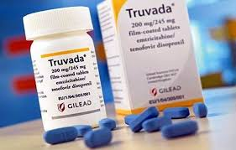
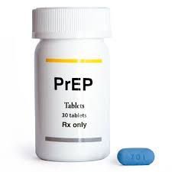
The first product
Date | Article
May 9, 2019 | Gilead Sciences to Provide Free Truvada for PrEP® to Support U.S. Initiative to End the HIV Epidemic
Jul 16, 2012 | Approval FDA Approves Truvada for Reducing the Risk of Sexually Acquired HIV Infection
Aug 2, 2004 | Approval Truvada Gilead Sciences, Inc. - Treatment for HIV Infection
May 17, 2004 | U.S. FDA Grants Priority Review to Gilead's Fixed Dose Co-Formulation of Viread and Emtriva for HIV
Mar 15, 2004 | Gilead Submits Applications to U.S. and European Regulatory Authorities for Fixed Dose Co-Formulation of Viread and Emtriva

Slide 17
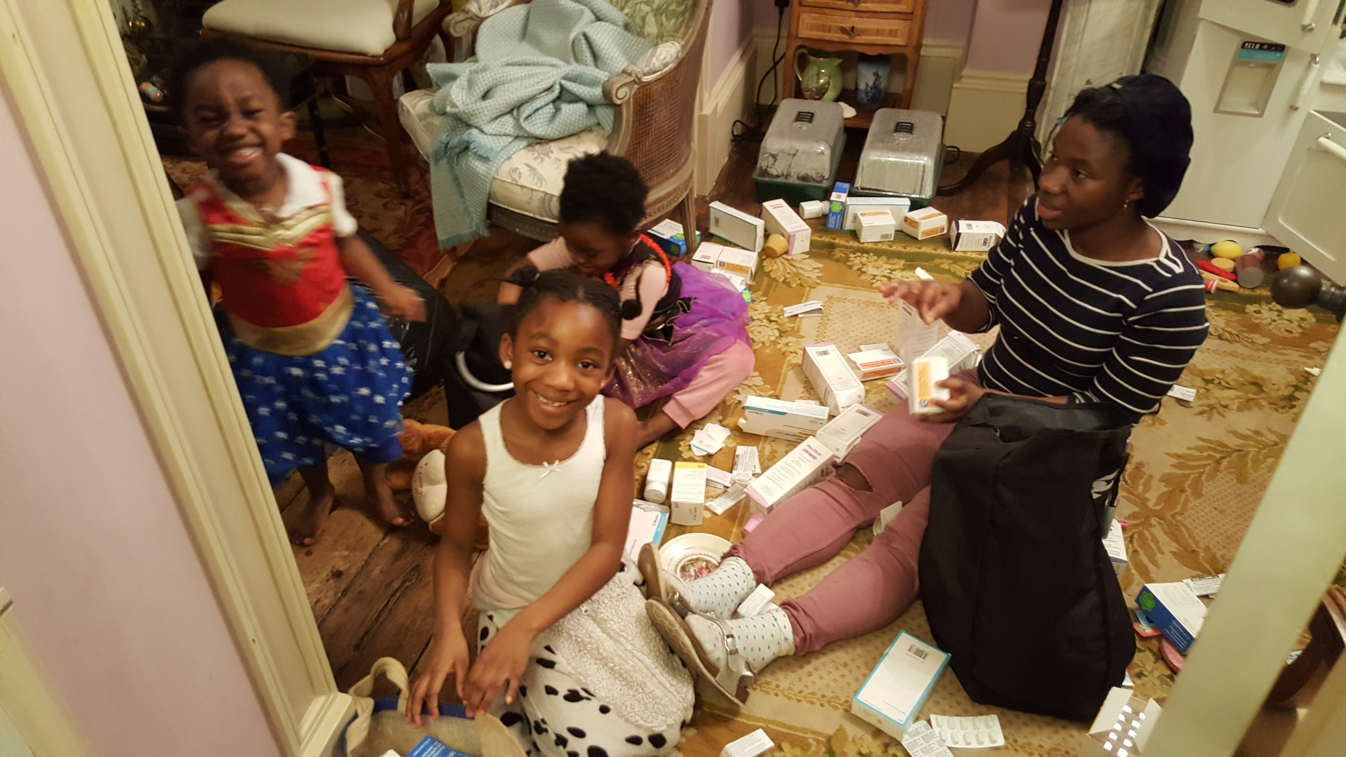
Now to the experts at using it

Slide 18
Now to the experts

