Slide 1
PrEP: an overview
Laura Waters FRCP MD
Consultant Physician Sexual Health & HIV
CNWL NHS Trust
@drlaurajwaters lwaters@nhs.net

Slide 2
Disclosures & disclaimers
Speaker/advisory fees: ViiV, Gilead, Janssen, MSD, Theratech, Cipla & Mylan
Investigator on clinical trials sponsored by Janssen & Gilead

Slide 3
Content
1
2
PrEP works!
Guidelines & targets
3
4
Challenges
Future
Notes:
This is what I will cover today…..

Slide 4
HIV prevention
U=U
undetectable=untransmissible
BEFORE SEX
Pre-exposure
prophylaxis (PrEP)
AFTER SEX
Post-exposure
prophylaxis (PEP)
Notes:
There are lots of effective HIV prevention methods:
Treating people with HIV so their viral loads are undetectable means z zero risk of transmission to their sexual partner, so-called ‘undetectable is untransmittable’ or U=U
There is still a very small risk of vertical transmission during pregnancy (depending on when HIV treatment is started) and breastfeeding so, depending on the circumstances, a women ma be advised to have a caesarean instead of a vaginal delivery and the baby will get medication for 2-4 weeks. In some countries formula feeding is recommended over breast feeding.
Condoms work and also reduce the risk of other sexually transmitted infections and unintended pregnancy
Finally using HIV drugs in HIV negative people before sex (pre-exposure prophylaxis or PrEP) or after sex (post-exposure prophylaxis or PEP) are effective ways to reduce the risk of HIV although there is far more evidence for PrEP than PEP….

Slide 5
What do we use for PrEP?
Tenofovir-disoproxil
+ emtricitabine
(Truvada®)
TDF/FTC
Notes:
Most evidence for PrEP, and most use globally, is with a 2 drug combination of tenofovir-disoproxil with emtricitabine, both commonly used in HIV treatment
These are commonly abbreviated to TDF/FTC

Slide 6
A lesson in tenofovirs
Tenofovir-disoproxil fumarate
= old tenofovir = TDF
But generics may be different
salts hence = TDX
Tenofovir-alafenamide =
new tenofovir = TAF

Slide 7
To further confuse things…..brand names!
TDF/FTC = Truvada
TAF/FTC = Descovy

Slide 8
PrEP works…..if you take it
Initially, randomised trials showed variable results:
Some studies showed low or no efficacy BUT good efficacy if detectable drug levels
Example: iPreX study
44% efficacy overall, 92% if detectable drug levels
Tenofovir-disoproxil
+ emtricitabine
(Truvada®)
Placebo
versus

Slide 9
PrEP really works….
86% efficacy
Notes:
Once the equipoise was lost, i.e. we knew that prep could work, we started seeing much better results.
IPERGAY was a placebo-controlled randomised trial of event-based PrEP (where you take PrEP before and after sex) and
PROUD randomised higher risk people to immediate vs deferred PrEP taken every day – both showed an 86% reduction in new cases of HIV
The open-label extension phase of IPERGAY showed a 97% reduction in new HIV cases

Slide 10
The European PrEP timeline
WHO updated guidelines
(oral PrEP if HIV risk substantial)
Gilead submit TDF/FTC PrEP to EMA
TDF/FTC PrEP approved
October 2015 Early 2016 August 2016
EACS guidelines
(PrEP for MSM & TGW + condoms inconsistent)

Slide 11
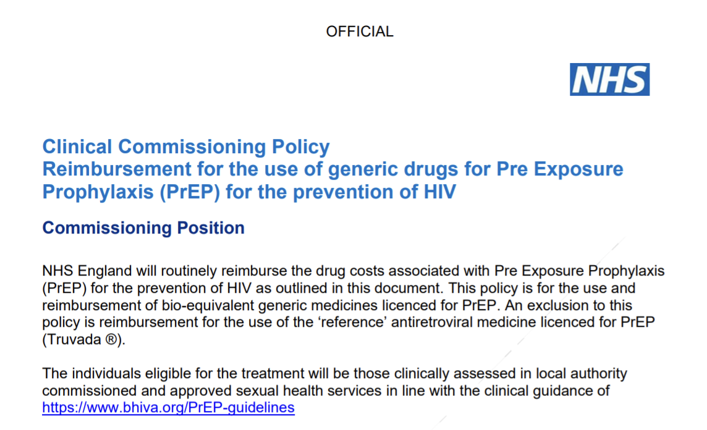
What happened in England?
2015-2016 PrEP policy drafted, consultation 01/2016
05/2016 NHS England decide they’re not responsible
08/2016 successful legal challenge by National AIDS Trust
NHSE funded another trial
10/2020 policy (at last!)

Slide 12
PrEP coverage is not good enough to meet global targets
We need better PrEP coverage to reach ZERO HIV transmissions
https://www.ecdc.europa.eu/en/publications-data/HIV-PrEP-eueea-and-uk-implementation-standards-monitoring-guidance

Slide 13
https://www.unaids.org/sites/default/files/media_asset/global-AIDS-strategy-2021-2026_en.pdf accessed 11th November 2021

Slide 14
To achieve a 90% reduction by 2030 vs 2010:
New HIV infections
AIDS- related deaths
https://www.unaids.org/sites/default/files/media_asset/global-AIDS-strategy-2021-2026_en.pdf accessed 11th November 2021

Slide 15
PrEP uptake targets by risk
Very high: 50%
Moderate: 5%
Low:0%
To achieve a 90% reduction by 2030 vs 2010:
New HIV infections
AIDS- related deaths
https://www.unaids.org/sites/default/files/media_asset/global-AIDS-strategy-2021-2026_en.pdf accessed 11th November 2021

Slide 16
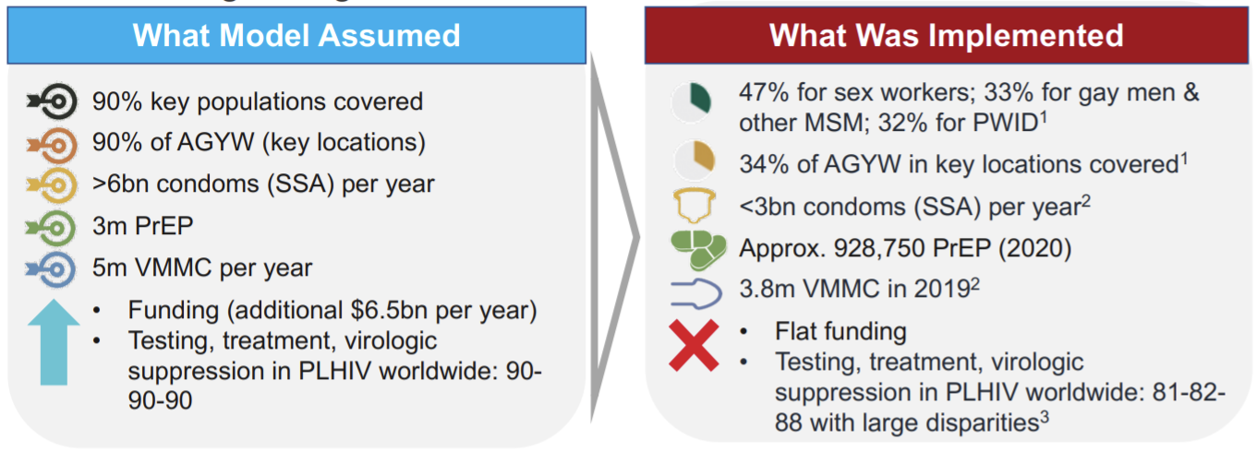
Where were we in 2020?
UNAIDS Fast-Track goals: reduce new HIV diagnoses to 500,000/yr by 2020
BUT major gaps in implementation across prevention modalities
Segal K. HIV Research For Prevention (HIV R4P; virtual); Jan 28, 2021 (abstr 1346).

Slide 17
Where were we in 2020?
UNAIDS Fast-Track goals: reduce new HIV diagnoses to 500,000/yr by 2020
BUT major gaps in implementation across prevention modalities
3 million
on PrEP
Segal K. HIV Research For Prevention (HIV R4P; virtual); Jan 28, 2021 (abstr 1346).

Slide 18
Where were we in 2020?
UNAIDS Fast-Track goals: reduce new HIV diagnoses to 500,000/yr by 2020
BUT major gaps in implementation across prevention modalities
3 million
on PrEP
1 million
on PrEP
Segal K. HIV Research For Prevention (HIV R4P; virtual); Jan 28, 2021 (abstr 1346).
Notes:
928,750

Slide 19
Where were we in 2020?
UNAIDS Fast-Track goals: reduce new HIV diagnoses to 500,000/yr by 2020
BUT major gaps in implementation across prevention modalities
3 million
on PrEP
0.1 million
on PrEP 2016
Segal K. HIV Research For Prevention (HIV R4P; virtual); Jan 28, 2021 (abstr 1346).
Notes:
928,750
9-fold increased in cumulative PrEP initiations over 4 years:102,446 in 2016 to 928,750 in 2020
PrEP initiation growth has slowed over time:
2017-2018 97%
2018-2019 58%
2019-2020 55%
BUT over 300,000 initiations in 2020 alone!

Slide 20
Global PrEP tracker
https://www.prepwatch.org/resource/global-prep-tracker/ accessed 5th May 2022

Slide 21
WARNING! THE NEXT SLIDE
IS STATING THE OBVIOUS!

Slide 22
‘Low continued use’
Many studies interpret discontinuation as ‘failure’
Risk, therefore need for PrEP, will change over time

Slide 23
‘Low continued use’
Many studies interpret discontinuation as ‘failure’
Risk, therefore need for PrEP, will change over time
Is someone stops PrEP after 3 months’ it may be
A PrEP access/tolerability/toxicity/adherence issue

Slide 24
‘Low continued use’
Many studies interpret discontinuation as ‘failure’
Risk, therefore need for PrEP, will change over time
Is someone stops PrEP after 3 months’ it may be
A PrEP access/tolerability/toxicity/adherence issue
That their sexual/injecting risk has changed
That their partner has tested HIV-negative
That their partner is now on suppressive ART

Slide 25
Current options
TDX/FTC
TAF/FTC
On demand dosing limited to MSM & TDF/FTC
Notes:
Mainly tenofovir-disoproxil/emtricitabine
Some TAF/emtricitabine use

Slide 26
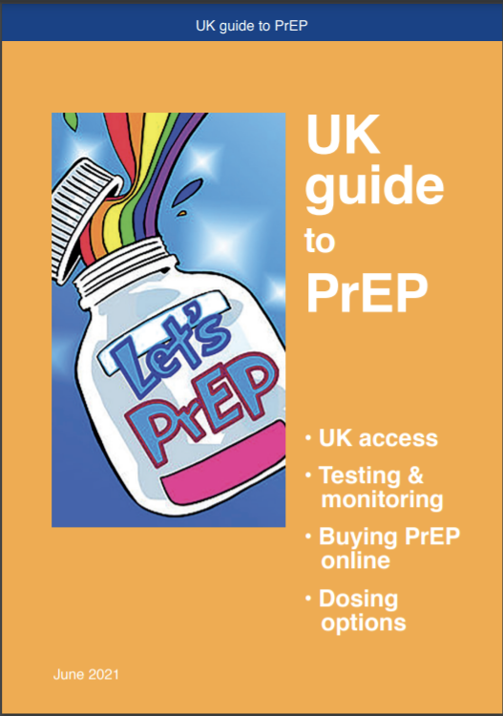
On demand (2-1-1)

Slide 27
No plans for Descovy PrEP in the EU
https://www.gilead.com/news-and-press/company-statements/gilead-announces-decision-not-to-pursue-marketing-authorization-for-descovy-for-pre-exposure-prophylaxis-in-the-european-union accessed 11/11/21

Slide 28
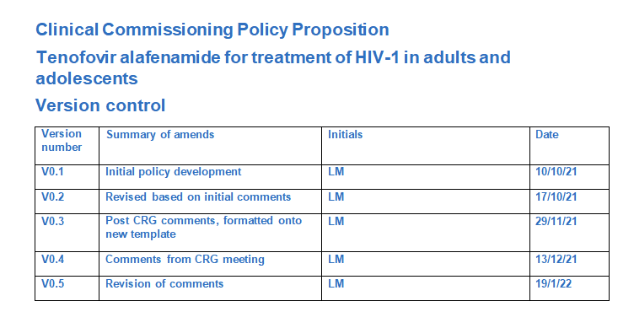
Coming soon
Notes:
One of the few, maybe only, benefits of Brxit is that we will have access to TAF/FTC PrEP as we now go via MHRA, our national regulatory body, rather than EMA, for drug approvals. This will be limited to people with renal or bone issues

Slide 29
HPTN 083: IM CAB vs TDF/FTC
2/39 with optimal adherence
74%* adherence
4/12 on time + good PK
92% adherence
*PK consistent with daily dosing
Landovitz RJ et al. N Engl J Med 2021;385:595-608
Notes:
HPTN083 compared oral TDF/FTC with injectable cabotegravir for PrEP in MSM & transgender women
Cabotegravir was superior but only due to adherence differences

Slide 30
Efficacy & adherence in HPTN084
HIV INCIDENCE
IM CAB: 0.2 (0.06-0.52)
TDF/FTC: 1.86 (1.30-2.57)
89% lower risk on CAB
(P = .000027)
PrEP ADHERENCE
IM CAB: 89-94%, 2/4 infections despite on time injections
TDF/FTC: 46% daily use (PK subset)
Delany-Moretlwe. HIVR4P 2021. Abstr HY01-02.
Notes:
HPTN084 is the same comparison as the last study but in cisgendered women at high risk of HIV and showed superiority driven by better adherence

Slide 31
Cost based on HPTN083 predicted 10 year outcomes (n=480,000)
Neilan AM .CROI 2021
Notes:
This US cost-effectiveness analysis shows TAF/FTC could never be cost-effective for routine PrEP in the US

Slide 32
Neilan AM .CROI 2021
Notes:
The same analysis showed cabotegravir would need to be much cheaper than the listed price

Slide 33
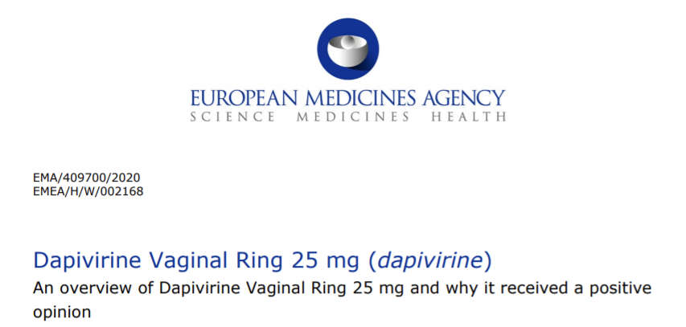
Dapivirine ring: 35% reduction in HIV
Monthly dosing
In phase 1 studies women prefer monthly to 3-monthly but prefer both to condoms

Slide 34
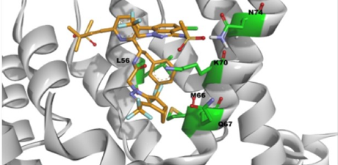
Pipeline long-acting options
OM ORAL ISL
ISL IMPLANT
LEN
RECRUITING
IMPOWER-022: ISL vs TDF/FTC in women
IMPOWER-024: ISL vs TDF/FTC vs TAF/FTC MSM & TGW
Ph1 data supports the potential to provide drug concentrations above the target PK threshold for at least one year
RECRUITING
PURPOSE 1: sc LEN vs PO LEN vs TDF/FTC vs TAF/FTC young F
PURPOSE 2: sc LEN vs PO LEN vs PO TDF/FTC
Hillier S et al, R4P 2021, Matthews RP et al. CROI 2021, all trials accessed at Clinicaltrials.gov 12th Novebmer 2021
Notes:
Phase 2 ISL data PK supports 60mg OM
PURPOSE 2 is in MSM, TGW, TGM*, GNB* who have sex with men

Slide 35
Notes:
Choice is crucial

Slide 36
Practicalities
Time to protection
Duration of protection
Adherence
Hepatitis B
HIV testing
HIV acquisition on PrEP

Slide 37
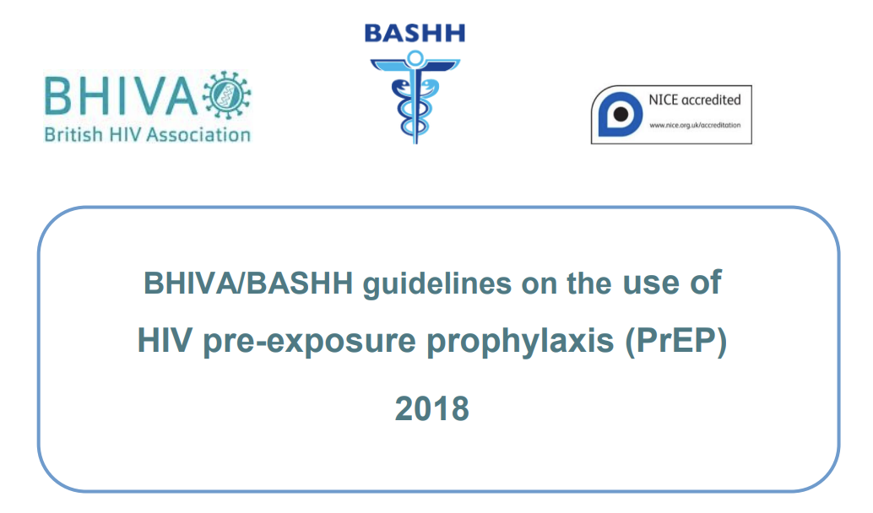
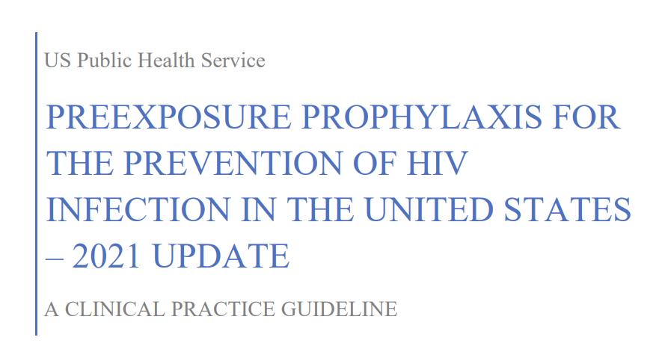
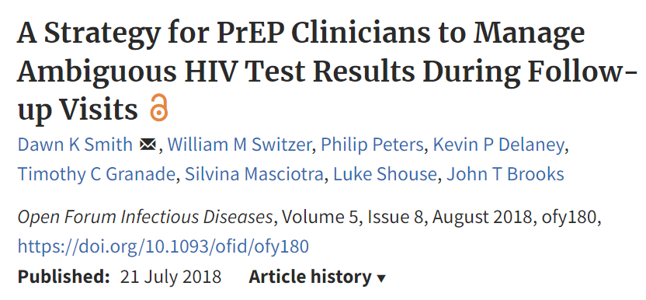
Guidelines

Slide 38
Practicalities
Time to protection: 7 days for vaginal/frontal sex, less for anal
Duration of protection: 7 days after stopping
Adherence: min 6 days a week for vaginal/frontal, less for anal
Hepatitis B: daily PrEP, not on demand, in liaison with specialist
HIV testing: 3-monthly (2-monthly for CAB) with Ag/Ab +/- RNA
HIV on PrEP: tests can be odd & RNA UD, WB/DNA/expert input
Notes:
Based on iPreX data for anal sex: 7 days a week = 99%, 4 days a week = 96%, 2 days a week = 76%

Slide 39
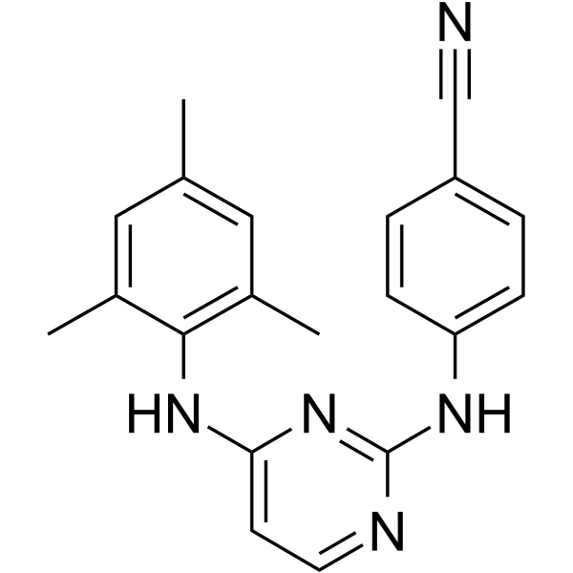
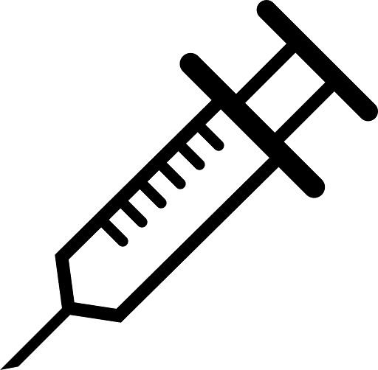
Under-studied issues
Notes:
IM CAB seems safe in rats & rabbits….
Dapirivine reaches breast milk
Impact of different PrEP methods on quality of life and sexual pleasure

Slide 40
BUT…..
3 million
1 million

Slide 41
Thank you
?
lwaters@nhs.net
@drlaurajwaters

