Slide 2
So happy to be back in Montenegro!

Slide 3
What is JUSTRI
Not-for-profit organisation based in the UK
We work to improve education and interaction between patients, doctors and other healthcare workers, industry and governments in the area of HIV and allied conditions
We aim to do what people want and help them get what they need
We focus on SEE and MENA but also look to expand our help

Slide 4
Who are JUSTRI
A small core group who plan and co-ordinate projects
A much larger group of people who work with us as speakers and implementers
Doctors, nurses, patients, pharmacists
Finally all who come to our events who we hope will continue to be part of the family we have developed

Slide 5
Bless you Robin

Slide 6
Aims of this meeting
To teach about psychology and psychiatry in HIV
To discuss these issues within Montenegro
To find out what you need or want
This is your opportunity to ask for anything - use it
All the slides will be e-mailed to you after the meeting as well as your certificate

Slide 7
Housekeeping
Brancika knows everything – just ask her
If there is a fire just run
Toilets are somewhere in the building
Turn your phones off or to silent

Slide 8
What does JUSTRI do
Develop resources
Run meetings and trainings
Try to build and develop relationships
Focus on ‘Supporting the Front-line’
See it all at www.justri.org

Slide 9
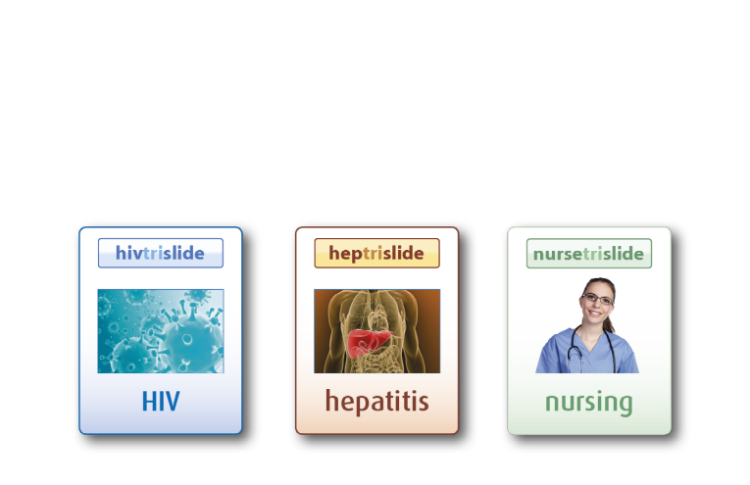
A free online slide library for HIV, TB, Hepatitis and Nursing
^{Now over 19,000 slides sets}

Slide 10
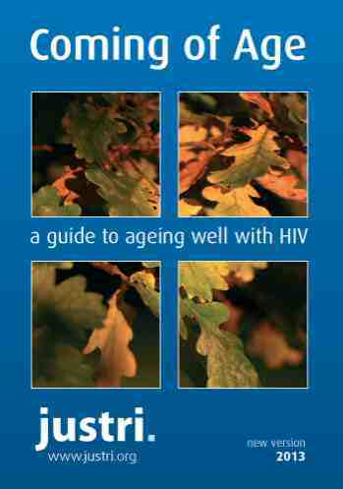
How-to Guides
HIV women’s clinic
Viral hepatitis clinic
HIV sexual health clinic
Could this be HIV?
Fibro Scan film guide
www.justri.org

Slide 11
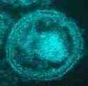
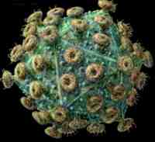
Key features of HIV
Reverse transcribes from RNA to DNA then integrates into host genome
High virus replication rate (10⁹-10¹⁰ virus particles daily)
Rapid virus clearance (half-life of cells actively producing virus <1 day, half-life of free virus in plasma a few hrs)
Persistence in latently infected cells (1 in 10⁶ resting CD4 T cells)
Viral genetic evolution
Chronic immune activation
Progressive depletion of CD4 T-cells (10⁸-10⁹ cells lost daily)
Progressive immune deficient state
Notes:
11

Slide 12
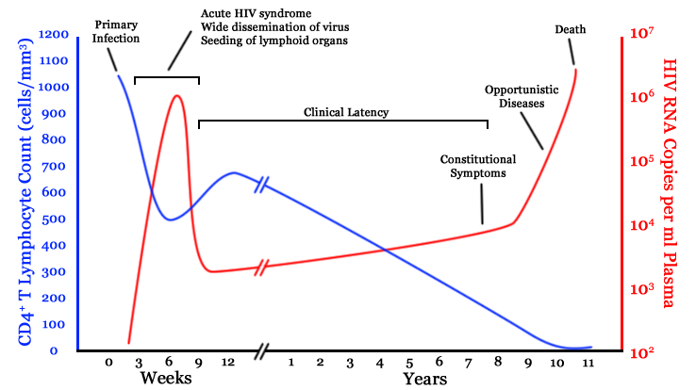
Natural history of HIV-1 infection
Notes:
12
Primary infection
May be asymptomatic or minimally symptomatic
Symptomatic in 50-70% of patients
Asymptomatic phase
From a few months to >10 yr
Characterised by high-levels of virus replication
Symptomatic phase
AIDS
Defined by the occurrence of opportunistic infections and tumours and other AIDS-defining disease

Slide 13
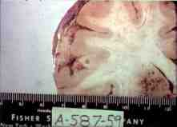
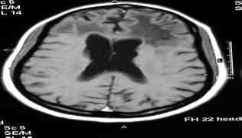
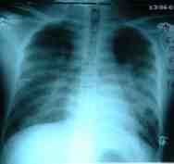
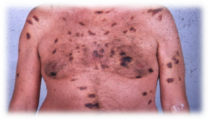
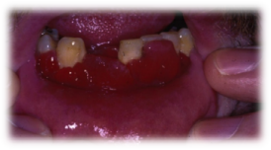
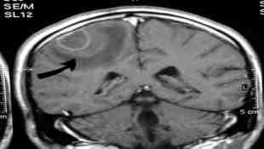
Characterised by unusual opportunistic infections and cancers
CDC – “no apparent danger to non-homosexuals from contagion”.
“The best evidence against contagion is that no cases have been reported to date outside the homosexual community or in women”
13

Slide 14
Notes:
14

Slide 15
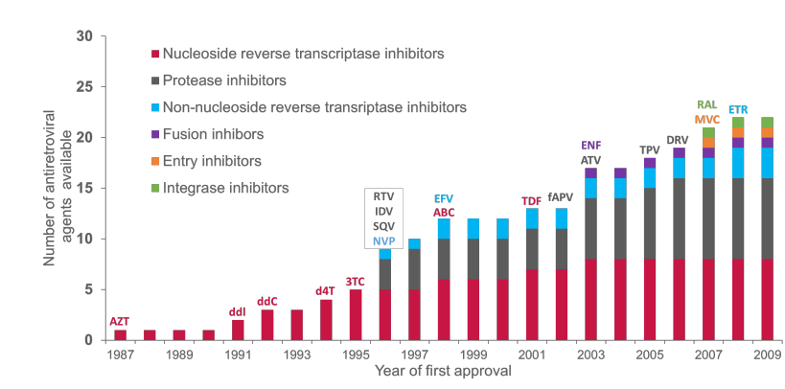
But advances in treatment brought new drugs and new classes
But advances in treatment brought new drugs and new classes..
DTG
RPV
ELV
DLV, delavrdine; DRV, darunavir; ENF, enfuvirtide; ETR, etravirine; fAPV, fosamprenavir; FTC, emtricitabine; IDV, indinavir; MVC, maraviroc; NFV, nelfinavir; RAL, raltegravir; TDF, tenofovir; TPV, tipranavir
AIDS Info Fact Sheet: FDA-Approved HIV Medicines. Available at http://www.aidsinfo.nih.gov (Accessed March 2016)
AIDS Info HIV/AIDS news, June 22, 1992. Available at http://www.aidsinfo.nih.gov (Accessed March 2016)

Slide 16
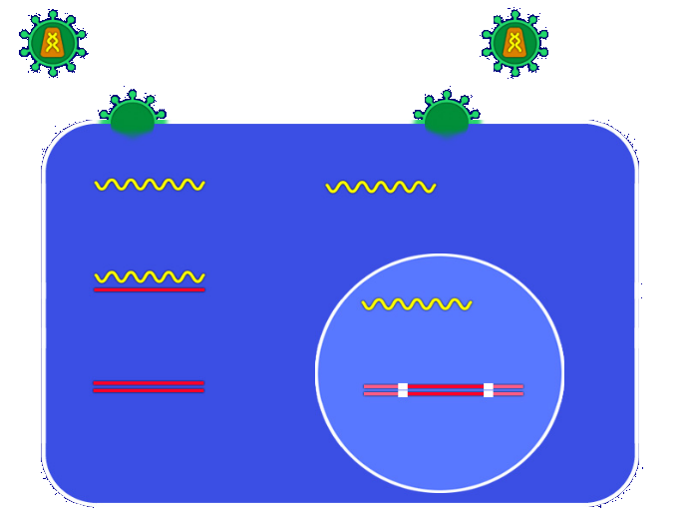
Atazanavir
Darunavir
Fosamprenavir
Indinavir
Nelfinavir
Lopinavir/r
Ritonavir
Saquinavir
Tipranavir
Current targets of antiretroviral therapy
Maraviroc
Co-receptor binding
T-20
Fusion
RNA
RNA
Protein cleavage
Proteins
Reverse transcription
RT
Abacavir
Didanosine
Emtricitabine
Lamivudine
Stavudine
Zidovudine
Tenofovir
Nevirapine
Efavirenz
Etravirine
RNA
RNA
Raltegravir
Elvitegravir
Dolutegravir
DNA
RT
DNA
Integration
DNA
Provirus
Notes:
16

Slide 17
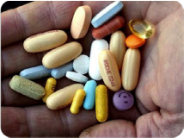
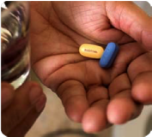
Simplifying treatment improved adherence...
1995
2006

Slide 18
Impact of Testing, PrEP and TasP
San Francisco¹:
HIV diagnoses dropped from 392 (2013) to 223 (2016): 43%
Median time from diagnosis to viral suppressions dropped from 134 to 61 days
Proportion of PrEP eligible MSM receiving PrEP increased from 10% to 42%
New South Wales (Australia)²
7,293 high risk MSM recruited to open-label PrEP study
Background of high rates of testing and treatment
35% reduction in HIV diagnoses
44% reduction in early HIV infections
¹Cohen S et al. Getting to zero new HIV diagnoses in San Francisco: what will it take? CROI 2018. Abstract 87
²Guy R et al. Rapid reduction in HIV diagnoses after targeted PrEP implementation in NSW, Australia

Slide 19
New JUSTRI guide at www.justri.org available in Serbian later this year

Slide 20
Time to get going – are you ready!

