Slide 1
Cases
Laura Waters & Andrew Scourfield

Slide 2
Content
1
2
Case 1
Case 2
3
4
Closing
thoughts
Case 3

Slide 3
1
CASE 1: MRS T

Slide 4
Mrs T
48 year old white British woman
Married, monogamous, non-smoker, social drinker
2012
Sees GP, fatigued, dry skin
Reassured, advised rest & emollients
2013
Recurrent vaginal candida
Fatigue
Thyroid & haematinics normal, Hb 115, platelets 90

Slide 5
Mrs T
2014
Fatigued, prescribed antidepressants
Seborrheic dermatitis, topical treatment
CIN-2, excised
Sexual history revised, monogamous & married
2015
Fevers, night sweats, weight loss
Ends up admitted to hospital
Diagnosed with diffuse B-cell lymphoma
HIV TEST REACTIVE, CD4 120

Slide 6
Missed opportunities & lessons
Several indicator conditions
Seborrheic dermatitis
Recurrent candida
Thrombocytopenia
ALL MISSED OPPORTUNITIES TO TEST
One monogamous partner does not mean two monogamous partners
Husband subsequently tests HIV-positive, paid sex in Thailand & Kenya

Slide 7
2
CASE 2: MR V

Slide 8
Mr V
42 year old man who has sex with men
HIV since 2002
CD4 >500 and HIV-RNA undetectable on ARVs
October 2015
Attends ED after a night on GHB & cocaine
Chest pains with T-wave changes & elevated troponin
HIV team not involved, discharged to primary care
February 2016
Attended HIV clinic, referred to cardiology….

Slide 9
Mr V: cardiology review
Reviews notes: October event was clearly an MI
Urgent angiogram
Significant lesion in left anterior descending artery
Stenting + usual post-MI prophylaxis
People with HIV get more age-related co-morbidities than HIV-negative people

Slide 10
Why?
HIV
HIV
drugs
Traditional (and less traditional) risk factors

Slide 11
Lessons
Illicit drug use detracts from other aetiologies
People with HIV may present with co-morbidities at a younger age – lower the threshold of suspicion

Slide 12
3
CASE 3: MR X

Slide 13
Mr X
68 year old man living in Brighton
Medical history
Nil significant
Drug history
Atorvastatin 20mg OD
Social history
Retired accountant
Lives with 4 cats and a parakeet
30 pack year smoker, moderate alcohol

Slide 14
Mr X
February 2017
Sees primary care doctor, 2 weeks non-productive cough
Chest clear, temperature normal, reassured
March 2017
Sees primary care doctor, short of breath when swimming, small amounts white sputum
Normal examination, treated with doxycycline
April 2017
Attends local emergency department
Severe shortness of breath, persistent cough
What would you do?

Slide 15
Mr X: results
Examination & observations
Chest clear
Temperature 37.9ºC, pulse 120 bpm, BP 105/60
Respiratory rate 24, O2 saturation 95%
Blood tests
Renal & liver profiles normal, CRP 35
Hb normal, platelets 90
Chest X-ray
Bilateral hazy shadowing

Slide 16
Mr X: treatment
Treated for presumed community acquired pneumonia:
IV amoxicillin + clarithromycin
Day 3:
No improvement
Arterial blood gas pO2 7.8kPa
Undergoes bronchoscopy…..
Pneumocystis jirovecii!
Treatment started (co-trimoaxazole + steroids)

Slide 17
Mr X
Has an HIV test
Reactive point of care test
Confirmed with laboratory test
Subsequently CD4 90, viral load 130,000
Notes review: low platelets in 2012, previous shingles
Why was he not tested sooner?

Slide 18
Let’s go back to the beginning…. on admission
Heterosexual male smoker with a chest infection…..I don’t need to request an HIV test!
NICE BUT SLIGHTLY
AWKWARD GENERAL
PHYSICIAN
No
Hello Mr X, can I ask some personal questions ….do you have sex with men?

Slide 19
HIV doctor goes to see Mr X
SUPER
COOL HIV
PHYSICIAN
But darling – I don’t have sex with men, MEN HAVE SEX WITH ME!
Hello Mr X, as you know your test showed you have HIV
I wanted to review your risk factors….you said you don’t have sex with men?

Slide 20
Key messages
Important to revisit the history & ask the right questions!
If any condition is unexplained or atypical….think HIV
Missed opportunities…..

Slide 21
4
CASE 4: MR X

Slide 22
Mr Z
48 year old HIV+ MSM
HIV well controlled
ALT 1100
Result called through Friday afternoon
Patient contacted by HIV team to attend A&E next day for repeat bloods
Seen by…..Andrew!

Slide 23
Mr Z
Repeat ALT 1300
Coagulation normal
USS normal
History taken:
Condomless anal sex with several partners
Snorting drugs, shared equipment
What has he got? What tests would you send?

Slide 24
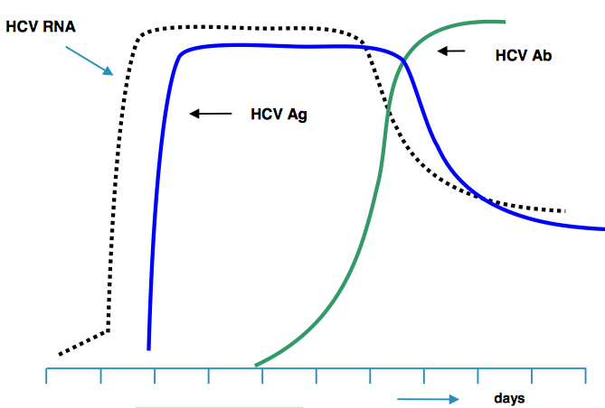
Hepatitis C tests

Slide 25
Mr Z
Phoned Mr Z
Advised most likely diagnosis acute HCV
3 days later:
Hepatitis C RNA negative
Case reviewed
Additional tests sent….
Acute hepatitis E
Sorry Mr Z

Slide 26
Key message
Assumptions can be wrong!

Slide 27
Key messages
Testing
Missed opportunities common, especially if ‘low risk’
Co-morbidities
HIV+ people can get ‘age-related’ issues at a younger age
Illicit drug use doesn’t mean the problem is not real
Late presentation
Missed opportunities common
More routine testing will improve this!
Hepatitis C
Outbreaks in HIV+ (& HIV-) MSM, RNA/Ag testing for acute
STI screen essential, re-infection is common

Slide 28
Key messages
Testing
Missed opportunities common, especially if ‘low risk’
Co-morbidities
HIV+ people can get ‘age-related’ issues at a younger age
Illicit drug use doesn’t mean the problem is not real
Late presentation
Missed opportunities common
More routine testing will improve this!
Hepatitis C
Outbreaks in HIV+ (& HIV-) MSM, RNA/Ag testing for acute
STI screen essential, re-infection is common

Slide 29
Thank you for listening: questions?
lwaters@nhs.net
andrew.scourfield@nhs.net
@laurajwaters
@drlaurajwaters
@Ascourfield_
@EggVintageBits
peoplefirstcharter.org
@flame_and_dame

