Slide 2
Narrow the Gaps in the HIV Treatment Cascade
Test
Engage, counsel, monitor, support
Retain, counsel, monitor, support
Adherence and viral suppression
HIV-Positive
ART Eligible
Link
HIV Care
(Pre-ART)
ART
UNDETECTABLE
HIV TESTING
Improved HIV rapid tests (e.g., oral tests)
Home- and community-based counseling and testing
HIV testing by community and lay health workers
Provider-initiated HIV testing and counseling and integration with primary care
Targeted mobile testing for hard-to- reach groups at schools, taxi ranks, farms, workplaces
PRE-ART REGULAR CLINIC CARE
Strong referral and linkage to care
Free HIV care and treatment
Point-of-care CD4 count testing
Rapid diagnosis and treatment of TB
Regular visits, TB and PCP prophylaxis
Support tools (mobile messages, patient-held appointment cards)
EARLY ART RETENTION IN CARE
Timely and/or earlier ART initiation
Adapted adherence support
Decentralization, primary care integration
Task-shifting
Non-toxic robust drugs; once-daily fixed-dose combinations
Viral load monitoring
Out-of-clinic care
LONG-TERM ART
AND UNDETECTABLE
VIRAL LOAD
Simplified clinical and refill schedules
Community-based, peer-supported ART
Viral load–triggered adherence support
Reliable drug supply, multiple month refills
Defaulter tracing
Sources: Top: adapted from: ML. McNairy and W. El-Sadr. “The HIV care continuum: no partial credit given,” AIDS (2012), 26: 1735-1738. Bottom: Médecins sans .Frontières/Doctors without Borders and UNAIDS (2012). “Speed scale-up: strategies, tools and policies to get the best HIV treatment to more people, sooner,” www.msfaccess.org/content/speed-scale-strategies-tools-and-policies-get-best-hiv-treatment-more-people-sooner, Accessed November 13, 2012

Slide 3
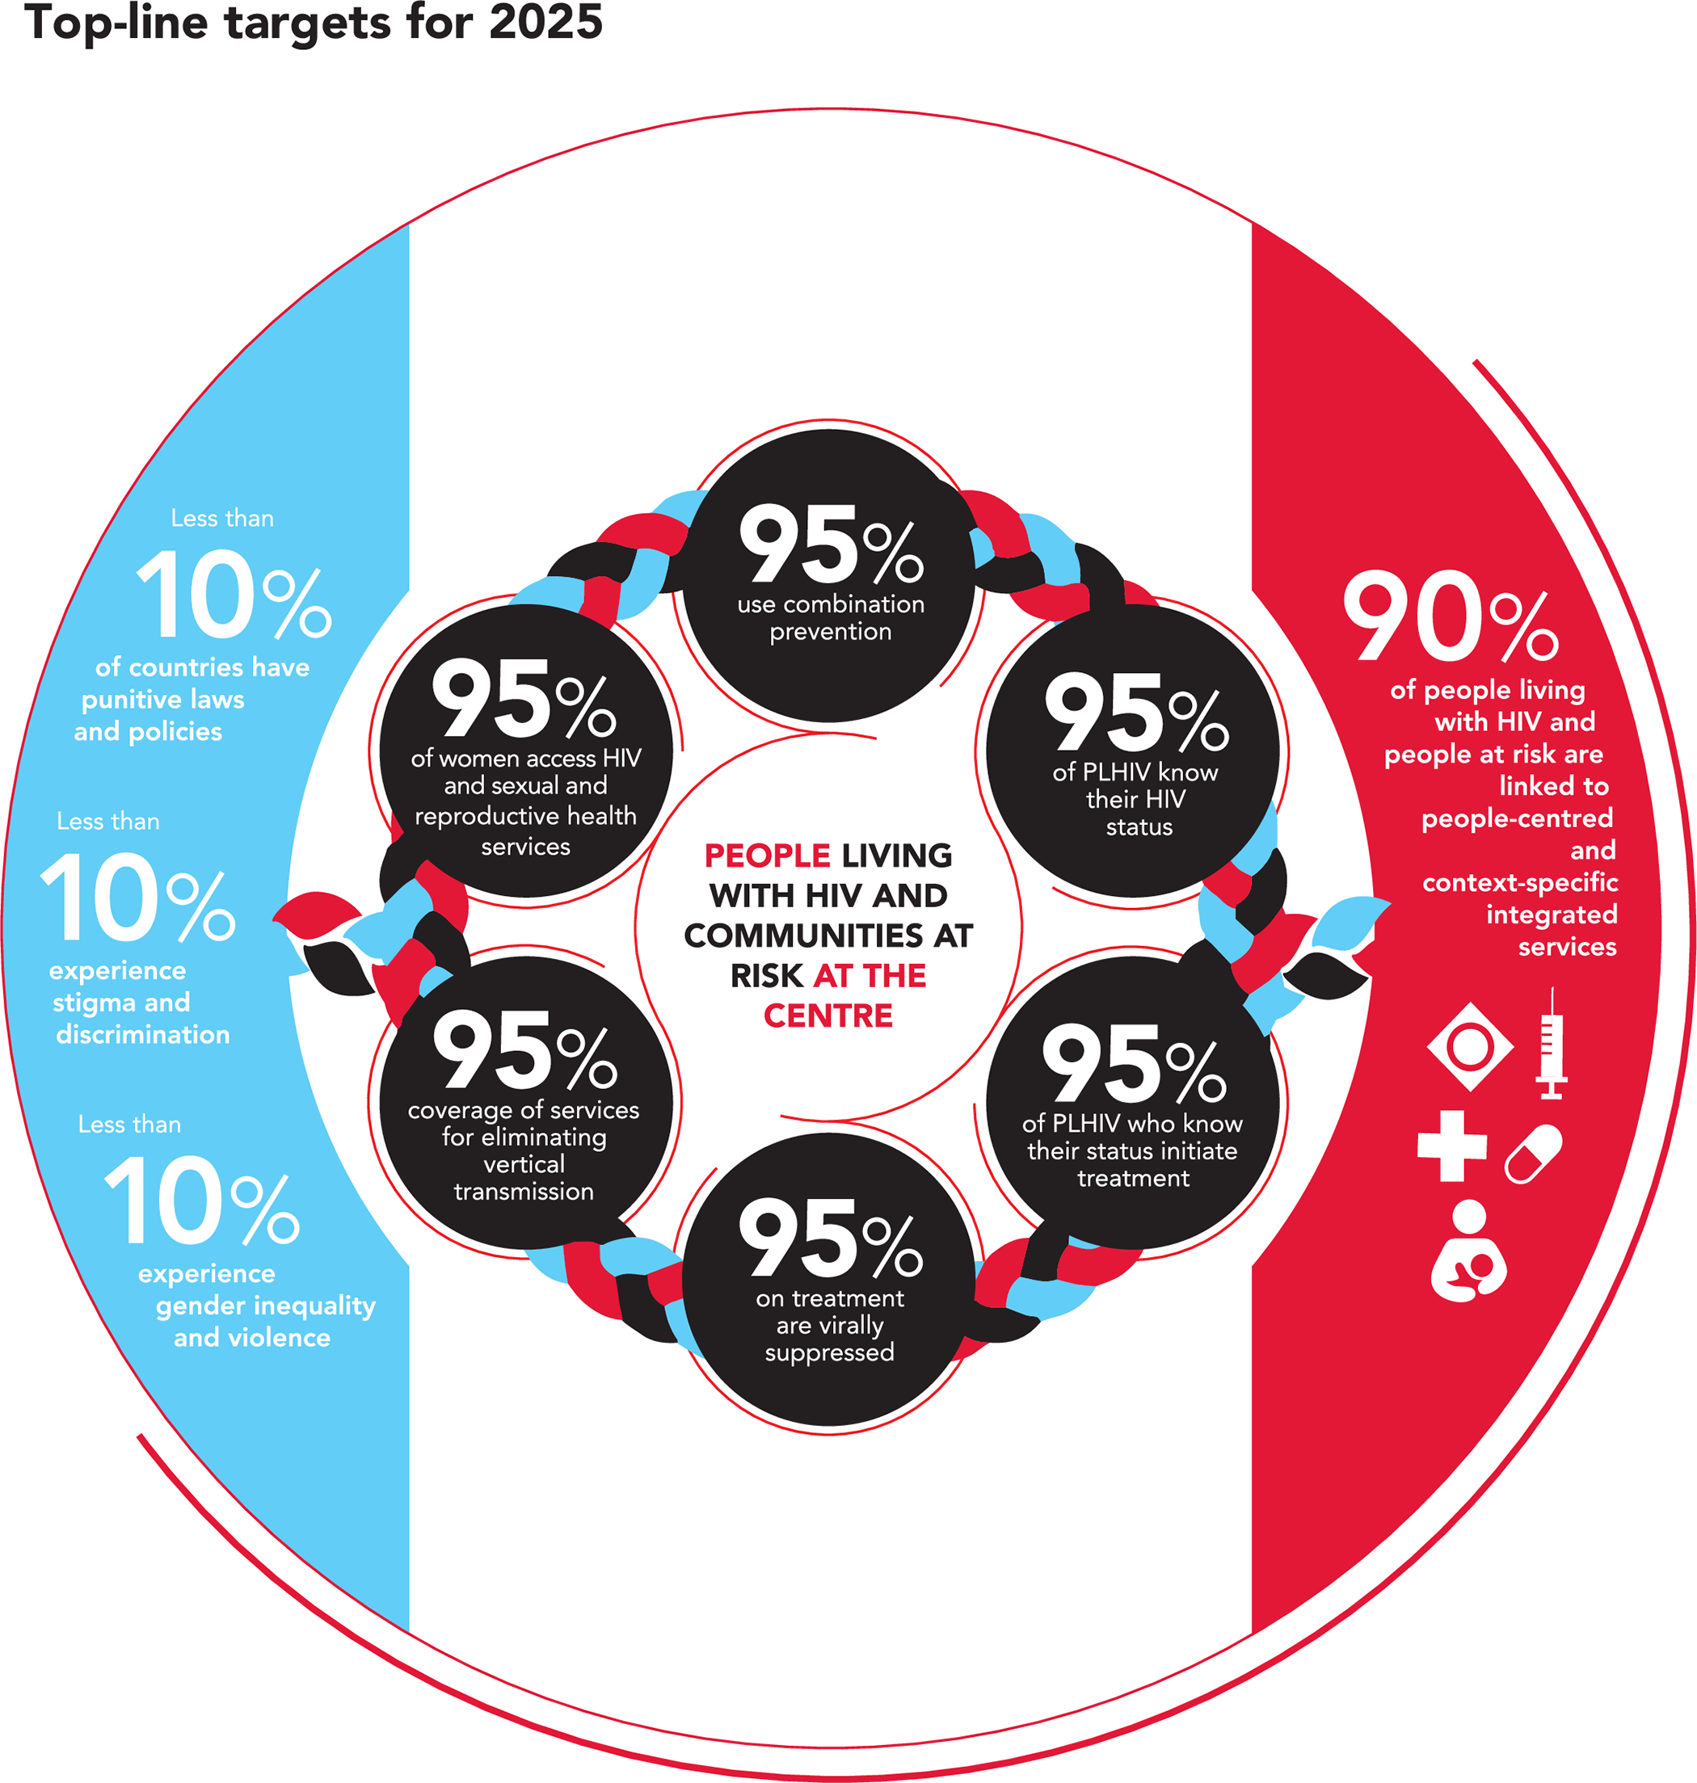

Slide 4
Paris Declaration 2014
End HIV epidemics in cities and municipalities by 2030
“Due to scientific breakthroughs, community activism, and political commitment, we have an opportunity to achieve Sustainable Development Goal 3.3 of ending the HIV epidemic by 2030. Cities and municipalities have been heavily affected by the epidemic and have been at the forefront of responding to HIV. Cities and municipalities are uniquely positioned to lead Fast-Track action towards achieving the United Nations (UN) 95-95-95 and other relevant targets. Attaining these targets will place us on a trajectory towards getting to zero new HIV infections and zero AIDS-related deaths.”

Slide 5
What role do nurses play?
Step 1: Aware of HIV status
HIV testing and linkage to care
follow-up of patients newly diagnosed to link them in to a service
expand testing opportunities
educate others
Step 2: On HIV treatment
supporting patients to start ART soon after diagnosis
management of ART
side effect management and adherence
retention and engagement in care
identify those at risk of disengagement – those with financial hardship, low levels of understanding and complex care needs

Slide 6
What role do nurses play?
Step 3: Viral suppression
follow-up appointments
documentation of viral load
encouragement and assessment of adherence
Step 4: Good health related quality of life
Healthy lifestyle
Mental health and well-being
Pain and symptom management and palliative care
Decrease stigma around HIV
Appreciation of Human Rights, mutual respect and inclusion of all people living with HIV
Non-judgemental approach, confidentiality

Slide 7
Questions?

