Slide 1
Nurse Management of medication and New Drug Developments
Anele Waters

Slide 2
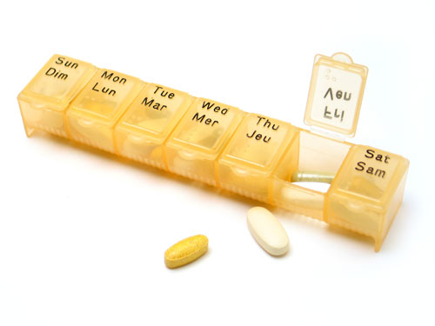

Antiretroviral treatment

Slide 3
Goals of HIV therapy
The primary goal is to prevent HIV-related morbidity and mortality.
Suppress HIV viral load to undetectable
Restore and/or preserve immunologic function
Prevent HIV transmission
Treatment is lifelong
Notes:
Stops the Viral load from replicating therefore allowing restoration of CD4
Undetectable doesn’t mean its not there, but at lowest level we can measure ie <20 copies per ml blood
Allowing immune system to replenesh allowing increased lifespan
Prevents HIV transmission ie greatly reduces the risk of HIV transmission with an undetectable viral load

Slide 4
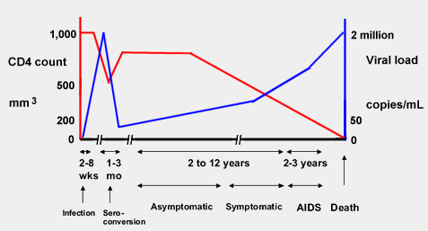
Natural progression of CD4 cells and HIV Viral load in the absence of HIV treatment
Source: HIV i-base
http://i-base.info/ttfa/section-2/214-how-cd4-and-viral-load-are-related/

Slide 5
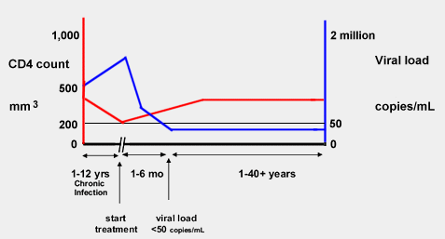
Effect of HIV treatment on CD4 count and viral load
Source: HIV i-base
http://i-base.info/ttfa/section-2/214-how-cd4-and-viral-load-are-related/

Slide 6
ART Classes
CCR5 Antagonist
Fusion Inhibitors
Integrase Inhibitors
Reverse Transcriptase (RT) Inhibitors
  NRTI, NNRTI
Protease Inhibitors (PIs)

Slide 7
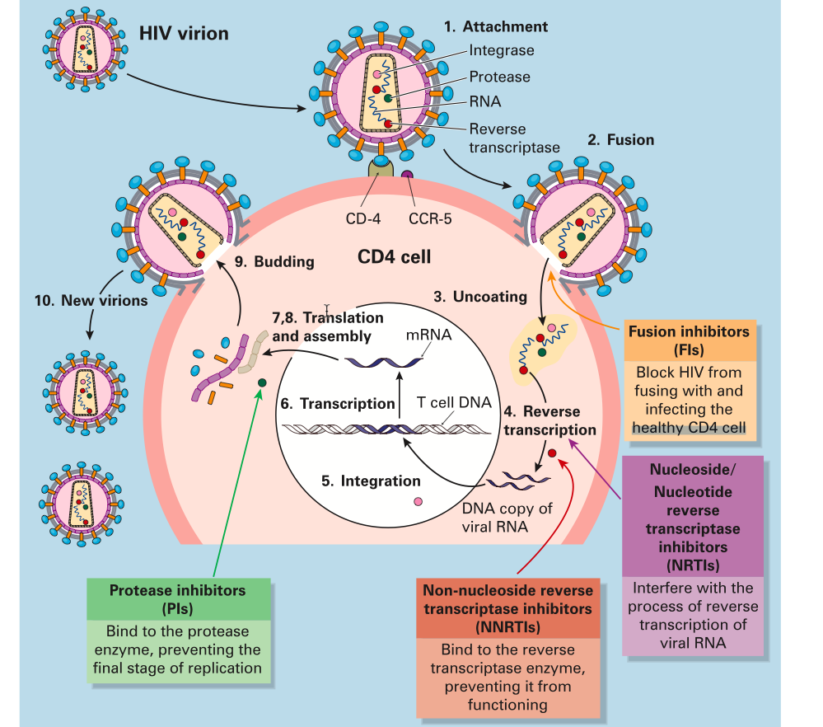
Notes:
HIV penetrates its target
HIV releases RNA into the cell. RNA must be converted to DNA by an enzyme called reverse transcriptase.
The viral DNA enters the cell's nucleus. Viral DNA becomes integrated with the cell's DNA by integrase enzyme
The DNA of the infected cell now produces RNA.
A new virus is assembled from RNA.
The virus pushes (buds) through the membrane of the cell, pinching off from the infected cell.
To be able to infect other cells, the budded virus must mature. It becomes mature when another HIV enzyme (HIV protease).

Slide 8
Problems with ART
There are reservoir sites for HIV
ART cannot penetrate into some areas
We cannot eradicate the virus completely --> weigh up health benefits with commencing life long treatment
So…when to start?
Notes:
The body contains reservoir sites for HIV-1 even during during virally suppressive (HAART).
RNA hides within other cells without replicating in this form for significant periods of time. It can then start to replicate at any time.
Also there are places in the body that antiretroviral therapy may not be able to penetrate such as in the brain, testes, kidney or heart.
8

Slide 9
EACS Guidelines (2021) v11.0
Starting ART on the same day after establishing a diagnosis of HIV infection is feasible and acceptable to HIV-positive persons.
Assessment of the readiness to start ART is essential for the person to express their preference and not feel pressured to start ART immediately, unless clinically indicated.
The lower the CD4 count, the greater the urgency to start ART immediately (European AIDS Clinical Society)

Slide 10
EACS (2021) Recommendations
ART recommended with any CD4 count to :
prevent progression of HIV disease
reduce risk of co-morbid conditions
prevent sexual transmission
prevent mother-to-child transmission

Slide 11
Blood tests before starting
CD4
Viral load
Tropism test
Resistance assay
HLA B*5701
Liver function tests
FBC

Slide 12
Before selecting an ART regimen, it is critical to review:
• If a woman wishes to conceive or is pregnant:
• If the person has an opportunistic infection:
• If the person has TB:
• If the person has potential treatment limiting comorbidities:
• If the person is being treated with other medications:
• If the person has swallowing difficulties:
• If the person has acquired HIV while receiving PrEP:
https://www.eacsociety.org/media/final2021eacsguidelinesv11.0_oct2021.pdf

Slide 13
ART-naïve Adult HIV-positive Persons : What to start with
Recommended
2 NRTIs + INSTI
1 NRTI + INSTI
2 NRTIs + NNRTI
Alternate
2 NRTIs + PIr / PIc
Notes:
2 NRTIs + INSTI
ABC/3TC + DTG ABC/3TC/DTG
HLA-B*57:01 negative HBsAg negative
I (ABC: HLA-B*57:01, cardiovascular risk) II (Weight increase (DTG))
TAF/FTC/BIC
II (Weight increase (BIC, TAF))
TAF/FTC or TDF/XTC + DTG
II (Weight increase (DTG, TAF)) III (TDF: prodrug types. Renal and bone toxicity. TAF dosing)
TAF/FTC or TDF/XTC + RAL qd or bid
II (Weight increase (RAL, TAF)) III (TDF: prodrug types. Renal and bone toxicity. TAF dosing) IV (RAL: dosing)
1 NRTI + INSTI
XTC + DTG or 3TC/DTG
HBsAg negative HIV-VL < 500,000 copies/mL Not recommended after PrEP failure
II (Weight increase (DTG)) V (3TC/DTG not after PrEP failure)
2 NRTIs + NNRTI
TAF/FTC or TDF/XTC + DOR or TDF/3TC/DOR
II (Weight increase (TAF)) III (TDF: prodrug types. Renal and bone toxicity. TAF dosing) VI (DOR: caveats, HIV-2)
Alternates
2 NRTIs + NNRTI
TAF/FTC or TDF/XTC + EFV or TDF/FTC/EFV
At bedtime or 2 hours before dinner
II (Weight increase (TAF) III (TDF: prodrug types. Renal and bone toxicity. TAF dosing) VII (EFV: neuro-psychiatric adverse events. HIV-2 or HIV-1 group 0)
TAF/FTC or TDF/XTC + RPV or TAF/FTC/RPV or TDF/FTC/RPV
CD4 count > 200 cells/µL HIV-VL < 100,000 copies/mL Not on gastric pH increasing agents With food
II (Weight increase (TAF)) III (TDF: prodrug types. Renal and bone toxicity. TAF dosing) VIII (RPV: HIV-2)
2 NRTIs + PI/r or PI/c
TAF/FTC or TDF/XTC + DRV/c or DRV/r or TAF/FTC/DRV/c
With food
II (Weight increase (TAF)) III (TDF: prodrug types. Renal and bone toxicity. TAF dosing) IX (DRV/r: cardiovascular risk) X (Boosted regimens and drug-drug interactions)

Slide 14
Initial Combination Regimen for ART-naïve Adult HIV-positive Persons (EACS 2021 vs 11.0)
2 NRTIs + INSTI
ABC/3TC + DTG ABC/3TC/DTG | HLA-B*57:01 negative HBsAg negative | I (ABC: HLA-B*57:01, cardiovascular risk) II (Weight increase (DTG))
TAF/FTC/BIC |  | II (Weight increase (BIC, TAF))
TAF/FTC or TDF/XTC + DTG |  | II (Weight increase (DTG, TAF)) III (TDF: prodrug types. Renal and bone toxicity. TAF dosing)
TAF/FTC or TDF/XTC + RAL qd or bid |  | II (Weight increase (RAL, TAF)) III (TDF: prodrug types. Renal and bone toxicity. TAF dosing) IV (RAL: dosing)
1 NRTI + INSTI
XTC + DTG or 3TC/DTG | HBsAg negative HIV-VL < 500,000 copies/mL Not recommended after PrEP failure | II (Weight increase (DTG)) V (3TC/DTG not after PrEP failure)
2 NRTIs + NNRTI
TAF/FTC or TDF/XTC + DOR or TDF/3TC/DOR |  | II (Weight increase (TAF)) III (TDF: prodrug types. Renal and bone toxicity. TAF dosing) VI (DOR: caveats, HIV-2)
Alternates
2 NRTIs + NNRTI
TAF/FTC or TDF/XTC + EFV or TDF/FTC/EFV | At bedtime or 2 hours before dinner | II (Weight increase (TAF) III (TDF: prodrug types. Renal and bone toxicity. TAF dosing) VII (EFV: neuro-psychiatric adverse events. HIV-2 or HIV-1 group 0)
TAF/FTC or TDF/XTC + RPV or TAF/FTC/RPV or TDF/FTC/RPV | CD4 count > 200 cells/µL HIV-VL < 100,000 copies/mL Not on gastric pH increasing agents With food | II (Weight increase (TAF)) III (TDF: prodrug types. Renal and bone toxicity. TAF dosing) VIII (RPV: HIV-2)
2 NRTIs + PI/r or PI/c
TAF/FTC or TDF/XTC + DRV/c or DRV/r or TAF/FTC/DRV/c | With food | II (Weight increase (TAF)) III (TDF: prodrug types. Renal and bone toxicity. TAF dosing) IX (DRV/r: cardiovascular risk) X (Boosted regimens and drug-drug interactions)

Slide 15
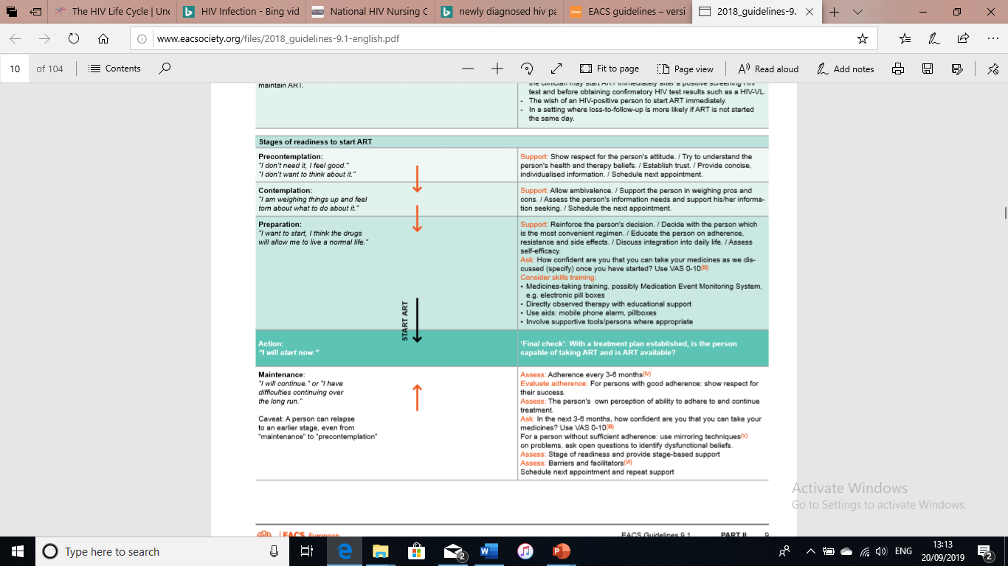
Understanding the 5 stages of readiness to start ART
Notes:
The trajectory from problem awareness to maintenance on ART can be divided into five stages. Knowing a person's stage, health care providers use appropriate techniques to assist them to start and maintain ART.

Slide 16
Reasons to Switch
1. Documented toxicity
2. Prevention of long-term toxicity.
3. Avoidance of drug-drug interactions.
4. Women wishing to conceive.
5. Ageing and/or comorbidity
6. Simplification: reduce pills, improve adherence.
7. Protection from Hepatitis B infection
8. Regimen fortification
9. Cost reduction
Notes:
1. Documented toxicity caused by one or more of the antiretrovirals included in the regimen.
2. Prevention of long-term toxicity. This may include person's concerns about safety
3. Avoidance of drug-drug interactions, page.
4. Planned pregnancy or women wishing to conceive.
5. Ageing and/or comorbidity with a possible negative impact of drug(s) in current regimen.
6. Simplification: to reduce pill burden, adjust food restrictions, improve adherence.
7. Protection from HBV infection or reactivation by including tenofovir in the regimen
8. Regimen fortification: Increasing the barrier to resistance of a regimen in order to prevent failure.
9. Cost reduction: switching to the generic form of their current regimen, if available

Slide 17
2 Drug regimens
EACS recommends as 1st line
DTV plus 3TC or FTC or DTV/3TC FDC (Dovato)
Dolutegravir (DTV) plus rilpivirine DTV/RPV FDC (Juluca)
Cabotegravir plus rilpivirine

Slide 18
2 Drug regimens
Cautions
VL >500,000
Tx at Dx (without resis or hx)
Hep B coinfection
Pregnancy
Prior use of PREP
Cognitive impairment

Slide 19
Injectables
Cabotegravir plus rilpivirine
Start with oral tablets x 1month
Injections Q2 monthly
3ml injections (2) to ventrogluteal site (left and right)

Slide 20
Benefits of Injectables
No daily tablets
Good for adherence?
Hard to reach individuals?
Mostly well tolerated
Reduces drug-drug interactions
Greater satisfaction for patients

Slide 21
Side Effects
Injection site reactions
Headache, dizziness
Depression, anxiety, difficulty in sleeping (insomnia), abnormal dreams
Raised temperature, feeling hot
Aches and pains, muscle pain
Tiredness, feeling weak
Nausea (feeling sick), vomiting, abdominal pain, diarrhoea
Rash

Slide 22

Notes:
22

Slide 23
ART Resistance

Slide 24
What is resistance?
HIV replicates billions of new viruses every day.
Mistakes happen with copies. These tiny differences are called mutations.
Some mutations cause the drugs to be less effective or not work at all.
These HIV strains are called drug-resistant.

Slide 25
HIV / ART resistance
Resistance predominantly occurs with poor adherence
Mutations during replication of the virus are not controlled by ART & are allowed to multiply
Resistant drugs lead to viral load failure
Resistance testing before ART & with loss of virological control
Notes:
No antiretroviral drug is resistance-proof HIV drug resistance may evolve naturally.
When HIV replication is not fully suppressed, drug resistance results.
This situation is frequently linked to non-adherence of ARV therapy.
Resistant viruses can spread and affect ARV therapy.
Transmission of HIV resistance strains is of increasing concern.
Early prevention of viral load failure (where the viral load becomes detectable) is important to reduce the incidence of resistance.
An elevated viral load may be a sign of poor adherence and with adherence counselling this may be brought under control if it is not too advanced.
HIV is “resistant” to a drug occurs if it keeps multiplying rapidly while taking ART.
Changes (mutations) in the virus cause resistance. HIV mutates almost every time a new copy is made. Not every mutation causes resistance.

Slide 26
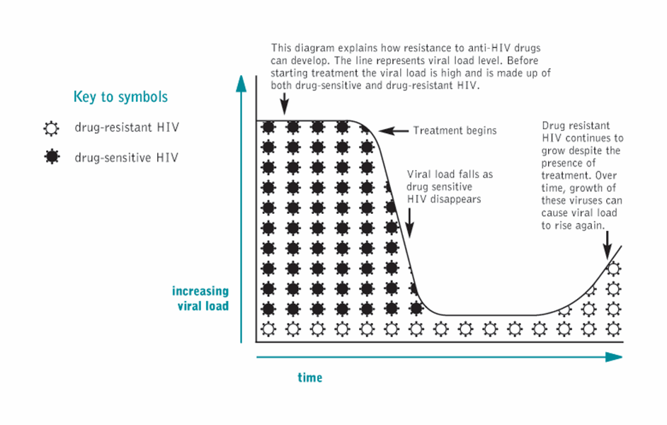
ART resistance
Notes:
When the patient starts to take the medication the viral load goes down and the drug sensitive virus decreases.
Once that is gone then the drug sensitive virus is then able to replicate with no pressure

Slide 27
Adherence as a leading cause of Resistance

Slide 28
Adherence associated Factors
Lack of understanding
Younger age
Psychosocial issues
Nondisclosure of HIV serostatus
Substance abuse
Stigma
Notes:
Lack of understanding- Not enough knowledge about how HIV works and how it affects the virus, Not taking the drugs will advance the HIV, just taking it sometimes will develop resistance
Younger age- youths and young adults and active life all kinds of things going on to but up barriers to adherence, late nights, partying, university, disclosure
Psychosocial issues housing, friends family issues
Nondisclosure of HIV serostatus taking drugs may somehow disclose their status
Substance abuse alcohol or drug use can make adherence difficult
Stigma

Slide 29
Adherence associated Factors
Personal commitment
Lifestyle and work
Difficulty with taking medication
Complex regimens and adverse drug effects
Cost issues
Support from partner, family, friends
Notes:
Personal commitment
Lifestyle and work- working nights, busy life, children
Difficulty with taking medication – physical problems with swallowing, psychological problems making it difficult,
Complex regimens and adverse drug effects; co morbidities making the number of tablets taken difficult, or interactions or different food restrictions
Cost issues- do they have to pay, can they pay?
Support from partner, family, friends lack of support has been shown to be a barrier, with support, people can remind them and emotionally support them through it

Slide 30
Consequences of poor adherence
Incomplete viral suppression
Continued destruction of immune system
Disease progression
Emergence of resistant strains
Limited future options

Slide 31
Nursing role in ongoing adherence
Acknowledge you understand it’s difficult
Confirm understanding of their regimen
Assess adherence
Find out reasons for missed doses
Ask about side effects
Offer suggestions to overcome obstacles
Notes:
acknowlede that difficulties taking antiretrovirals are common and inevitable at some point in treatment.
Your role is to help identify these difficulties and try to make it easier for the patient to take the medication.
Example:
Taking pills every day is really hard. Most people have problems taking their pills at some point during treatment. I am going to ask you about problems that you have had taking your pills. Please feel comfortable telling me about pills you may have missed or taken late; I am asking because I want to make it easier for you to take them.
Confirm Understanding of Regimen
Using a visual aid, such as a chart that shows color images of the available antiretroviral pills, ask the patients which medications they are taking.
For each of the indicated pills, ask how many and exactly how often they are taking them.
Ask if they have special instructions for any of the pills, such as dietary restrictions or extra fluid requirements.
If any answers are incorrect, it is important at this time to focus on clarifying the regimen prior to completing the adherence assessment.
Assess Adherence
Ask the patients about their adherence over the past 3 days, 1 day at a time.
Start with the day prior to the interview (ie, yesterday) and ask them how many of their pills they had missed or taken late that day.
Then ask about the 2 days prior to that, addressing each day separately. Next, ask about how many doses they had missed or taken late over the past 7 days and 30 days.
If they report no missing doses, ask them how long it has been since a dose was missed.
Alternatively, a visual analogue scale can be used to assess recent adherence using a more simple visual scale.
Ask About Reasons for Missing Doses
For patients that report missing any dose, ask them if they know the reasons why.
Prompt them if they cannot offer an explanation. Common reasons why people miss medications include simply forgetting, being away from home, being too busy with other things, a schedule change, too many side effects, feeling sick or depressed, and running out of pills.
Ask about Patient attitudes (beliefs and perceptions)
Discuss disclosure, family or friend support
Identify barriers (Housing, shared)
Integrate tx into patient daily routine
Ask About Medication Side Effects or Other Problems
Ask the patients about medication side effects or other problems that they may be experiencing.
Prompts can be offered, such as asking about nausea, diarrhea, difficulty swallowing the pills, headaches, fatigue, depression, or any other physical or emotional complaints.
Collaborate with the Patient to Facilitate Adherence
Reassure the patients again that problems with adherence are common.
Explain that your concern is based on the fact that missing more than 5-10% of the doses in a month (eg, more than 3-6 doses a month in a twice-daily regimen) can lead to the medications not working well anymore, and that missing less than this would be a good goal.
Take seriously all complaints about side effects or other physical or emotional problems and address them concretely. Offer suggestions to overcome specific obstacles the patients may have mentioned, such as the use of a watch alarm, medication organizer, extra packages of pills at work or in the car, or an unmarked bottle for enhanced privacy.
Ask the patients if they have any ideas of their own to make it easier to take the medications.
Finally, do not worry if the problem cannot be solved immediately; uncovering a problem with adherence is an important accomplishment and solutions to it can evolve in subsequent visits.

Slide 32
Multidisciplinary approach
Same message from all
Doctors
Nurses
Adherence message for the patient
Pharmacist
Counsellor

Slide 33
Side effects
Common (Short Term)
GI gastrointestinal-nausea, vomiting, diarrhoea
Central nervous system: headaches, fatigue, insomnia, dream, low mood
Rash
Long term
Lipids, Liver, bone density, weight gain

Slide 34
Summary
ART prolongs life
Adherence is important to preventing resistance
Side effects can be managed
Nurses can be an important support for those taking ART

